Slide 1
Artificial Neural Network– Back Propagation

Slide 2
Artificial Neural Network
A Back Propagation network learns by example.
You give the algorithm examples of what you want the network to do and it changes the network’s weights so that, when training is finished, it will give you the required output for a particular input.
Back Propagation networks are ideal for simple Pattern Recognition and Mapping Tasks
As mentioned, to train the network you need to give it examples of what you want – the output you want (called the Target) for a particular input.
Inputs
First Hidden layer
Second Hidden Layer
Output Layer
Function Signals
Error Signals

Slide 3
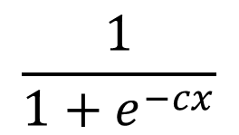
ANN Training
The backpropagation algorithm looks for the minimum of the error function in weight space using the method of gradient descent.
The combination of weights which minimizes the error function is considered to be a solution of the learning problem.
Since this method requires computation of the gradient of the error function at each iteration step, we must guarantee the continuity and differentiability of the error function.
One of the more popular activation functions for backpropagation networks is the sigmoid, a real function Sc : IR →(0, 1) defined by the expression
Three sigmoid (for c = 1, c = 2 and c = 3)
Higher values of c bring the shape of the sigmoid closer to that of the step function and in the limit c -> ∞ the sigmoid converges to a step function at the origin.
S_{c}(x) =
$$\frac{1}{1+e^{−cx}}$$

Slide 4
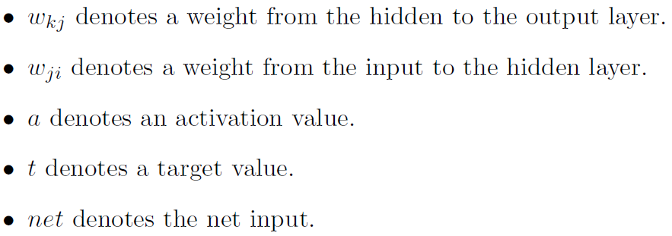
ANN Training

Slide 5
Slope and Derivative
f(x+h)-f(x)
Slope=
(x+h)-x
F(x+h)
f(x+h)-f(x)
df/dx=
h
F(x)
x
X+h
Slope/derivative/gradient gives the sensitivity of the function w.r.t. the small change in the variable.

Slide 6
Backpropagation,
Simple expressions and interpretation of the gradient
Consider a simple multiplication function of two numbers
It is a matter of simple calculus to derive the partial derivative for either input:
Interpretation. Actually Derivatives indicate the rate of change of a function with respect to that variable surrounding an infinitesimally small region near a particular point:
=
When h is very small, then the function is well-approximated by a straight line, and the derivative is its slope. In other words, the derivative on each variable tells you the sensitivity of the whole expression on its value.
Fore example if x= 4 and y =3 then f(x,y) =-12, and the derivative wrt x (df/dfx) =-3. This tells us that if we were to increase the value of this variable by a tiny amount the effect of the whole expression would be to decrease it and by amount three times the amount. This can be see by rearranging the above equation as
The derivative on each variable tells you the sensitivity of the whole expression on its value.

Slide 7
Gradient Descent Error
Backpropagation learning algorithm is basically a gradient descent on sum-squared error
The total error in a network is given by the following equation
We want to adjust the network’s weights to reduce this overall error.

Slide 8
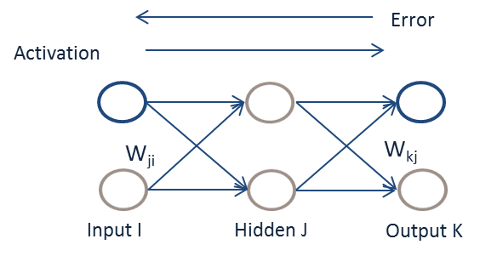
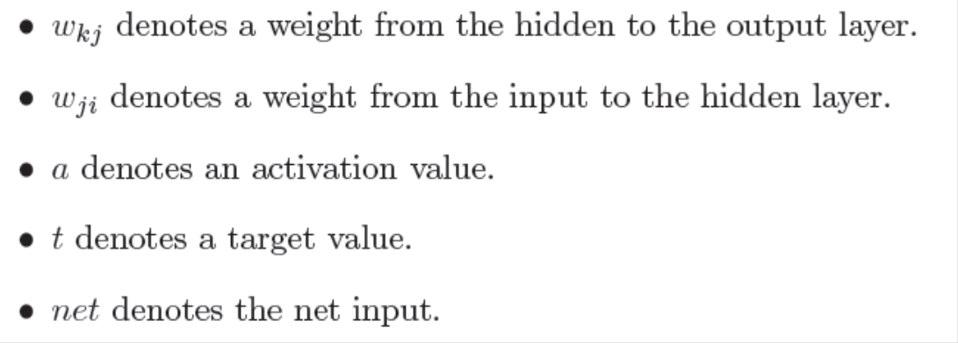
Lets begin at the output layer with a particular weight.
However error is not directly a function of a weight. We expand this as follows.
Let’s consider each of these partial derivatives in turn. Note that only one term of the E summation will have a non-zero derivative: the one associated with the particular weight we are considering.

Slide 9
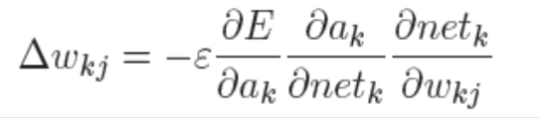

Weight change rule for a hidden to output weight
Derivative of the error with respect to the activation
Derivative of the net input with respect to a weight
Note that only one term of the net summation will have a non-zero derivative: again the one associated with the particular weight we are considering.
Derivative of the activation with respect to the net input
Now as
Weight change rule for a hidden to output weight
we can rewrite the result of the partial derivative as:
Change in weight is proportional to error at K multiplied by activation j. ie
Change in weight is proportional to error at (L+1)th layer multiplied by activation at Lth Layer.
Where a_{k} =

Slide 10
Compound expressions with chain rule
Consider the expression f(x,y,z) = (x+y) z
Let q=(x+y) then f= qz
df/dq = z and
df/fz = q = but q= (x+Y) => dq/dx=1, dq/dy =1
Chain Rule =
At the end we are left with the gradient in the variables [df/dx,df/dy,df/dz], which tell us the sensitivity of the variables x,y,z on f. This is the simplest example of backpropagation.

Slide 11
Slope and Derivative
f(x+h)-f(x)
Slope=
(x+h)-x
F(x+h)
f(x+h)-f(x)
df/dx=
h
F(x)
x
X+h
Slope/derivative/gradient gives the sensitivity of the function w.r.t. the small change in the variable.

Slide 12
Backpropagation,
Simple expressions and interpretation of the gradient
Consider a simple multiplication function of two numbers
It is a matter of simple calculus to derive the partial derivative for either input:
Interpretation. Actually Derivatives indicate the rate of change of a function with respect to that variable surrounding an infinitesimally small region near a particular point:
=
When h is very small, then the function is well-approximated by a straight line, and the derivative is its slope. In other words, the derivative on each variable tells you the sensitivity of the whole expression on its value.
Fore example if x= 4 and y =3 then f(x,y) =-12, and the derivative wrt x (df/dfx) =-3. This tells us that if we were to increase the value of this variable by a tiny amount the effect of the whole expression would be to decrease it and by amount three times the amount. This can be see by rearranging the above equation as
The derivative on each variable tells you the sensitivity of the whole expression on its value.

Slide 13
Compound expressions with chain rule
Consider the expression f(x,y,z) = (x+y) z
Let q=(x+y) then f= qz
df/dq = z and
df/fz = q = but q= (x+Y) => dq/dx=1, dq/dy =1
Chain Rule =
At the end we are left with the gradient in the variables [df/dx,df/dy,df/dz], which tell us the sensitivity of the variables x,y,z on f. This is the simplest example of backpropagation.

Slide 14

Weight change rule for an input to hidden weight
Now to determine the appropriate weight change for an input to hidden weight. This is more complicated because it depends on the error at all of the nodes this weighted connection can lead to.
Change in weight is proportional to error at (L+1)th layer multiplied by activation at Lth Layer.
For Change in weight form j to i
Error Propagated from K to J multiplied by rate of change of activation at j w r t net and weight
Error propagated from layer k to j is
The rate of change of activation at j wrt net and weight

Slide 15
Learning by Example
Training Algorithm: backpropagation of errors using gradient descent training.
Colors:
Red: Current weights
Orange: Updated weights
Black boxes: Inputs and outputs to a neuron
Blue: Sensitivities at each layer

Slide 16
First Pass
G1= (0.6225)(1-0.6225)(0.0397)(0.5)(2)=0.0093
G2= (0.6508)(1-0.6508)(0.3492)(0.5)=0.0397
0.6225
0.6225
0.6508
0.5
0.5
0.5
0.6508
0.5
1
0.5
0.5
0.5
0.5
0.6508
0.5
0.6225
0.5
0.6225
0.6508
Gradient of the neuron= G =slope of the transfer function×[Σ{(weight of the neuron to the next neuron) × (output of the neuron)}]
Gradient of the output neuron = slope of the transfer function × error
G3=(1)(0.3492)=0.3492
Error=1-0.6508=0.3492

Slide 17
Weight Update 1
New Weight=Old Weight + {(learning rate)(gradient)(prior output)}
0.5+(0.5)(0.0397)(0.6225)
0.5+(0.5)(0.3492)(0.6508)
0.5+(0.5)(0.0093)(1)
0.5124
0.5047
0.6136
0.5124
0.5124
0.5047
0.6136
0.5124

Slide 18
Second Pass
G1= (0.6236)(1-0.6236)(0.5124)(0.0273)(2)=0.0066
G2= (0.6545)(1-0.6545)(0.1967)(0.6136)=0.0273
0.6236
0.6391
0.6545
0.5047
0.5124
0.6136
0.8033
0.5047
1
0.5124
0.5124
0.5047
0.6136
0.8033
0.5047
0.5124
0.6236
0.6391
0.6545
G3=(1)(0.1967)=0.1967
Error=1-0.8033=0.1967

Slide 19
Weight Update 2
New Weight=Old Weight + {(learning rate)(gradient)(prior output)}
0.5124+(0.5)(0.0273)(0.6236)
0.6136+(0.5)(0.1967)(0.6545)
0.5047+(0.5)(0.0066)(1)
0.5209
0.508
0.6779
0.5209
0.5209
0.508
0.6779
0.5209

Slide 20
Third Pass
0.6243
0.6504
0.508
0.6571
0.5209
0.6779
0.8909
0.508
1
0.5209
0.5209
0.508
0.6779
0.508
0.5209
0.6571
0.8909
0.6243
0.6504

Slide 21
Weight Update Summary
W1: Weights from the input to the input layer
W2: Weights from the input layer to the hidden layer
W3: Weights from the hidden layer to the output layer
Training Algorithm
The process of feedforward and backpropagation continues until the required mean squared error has been reached.
Typical MSE : 1e-5

Slide 22
